Slide 1

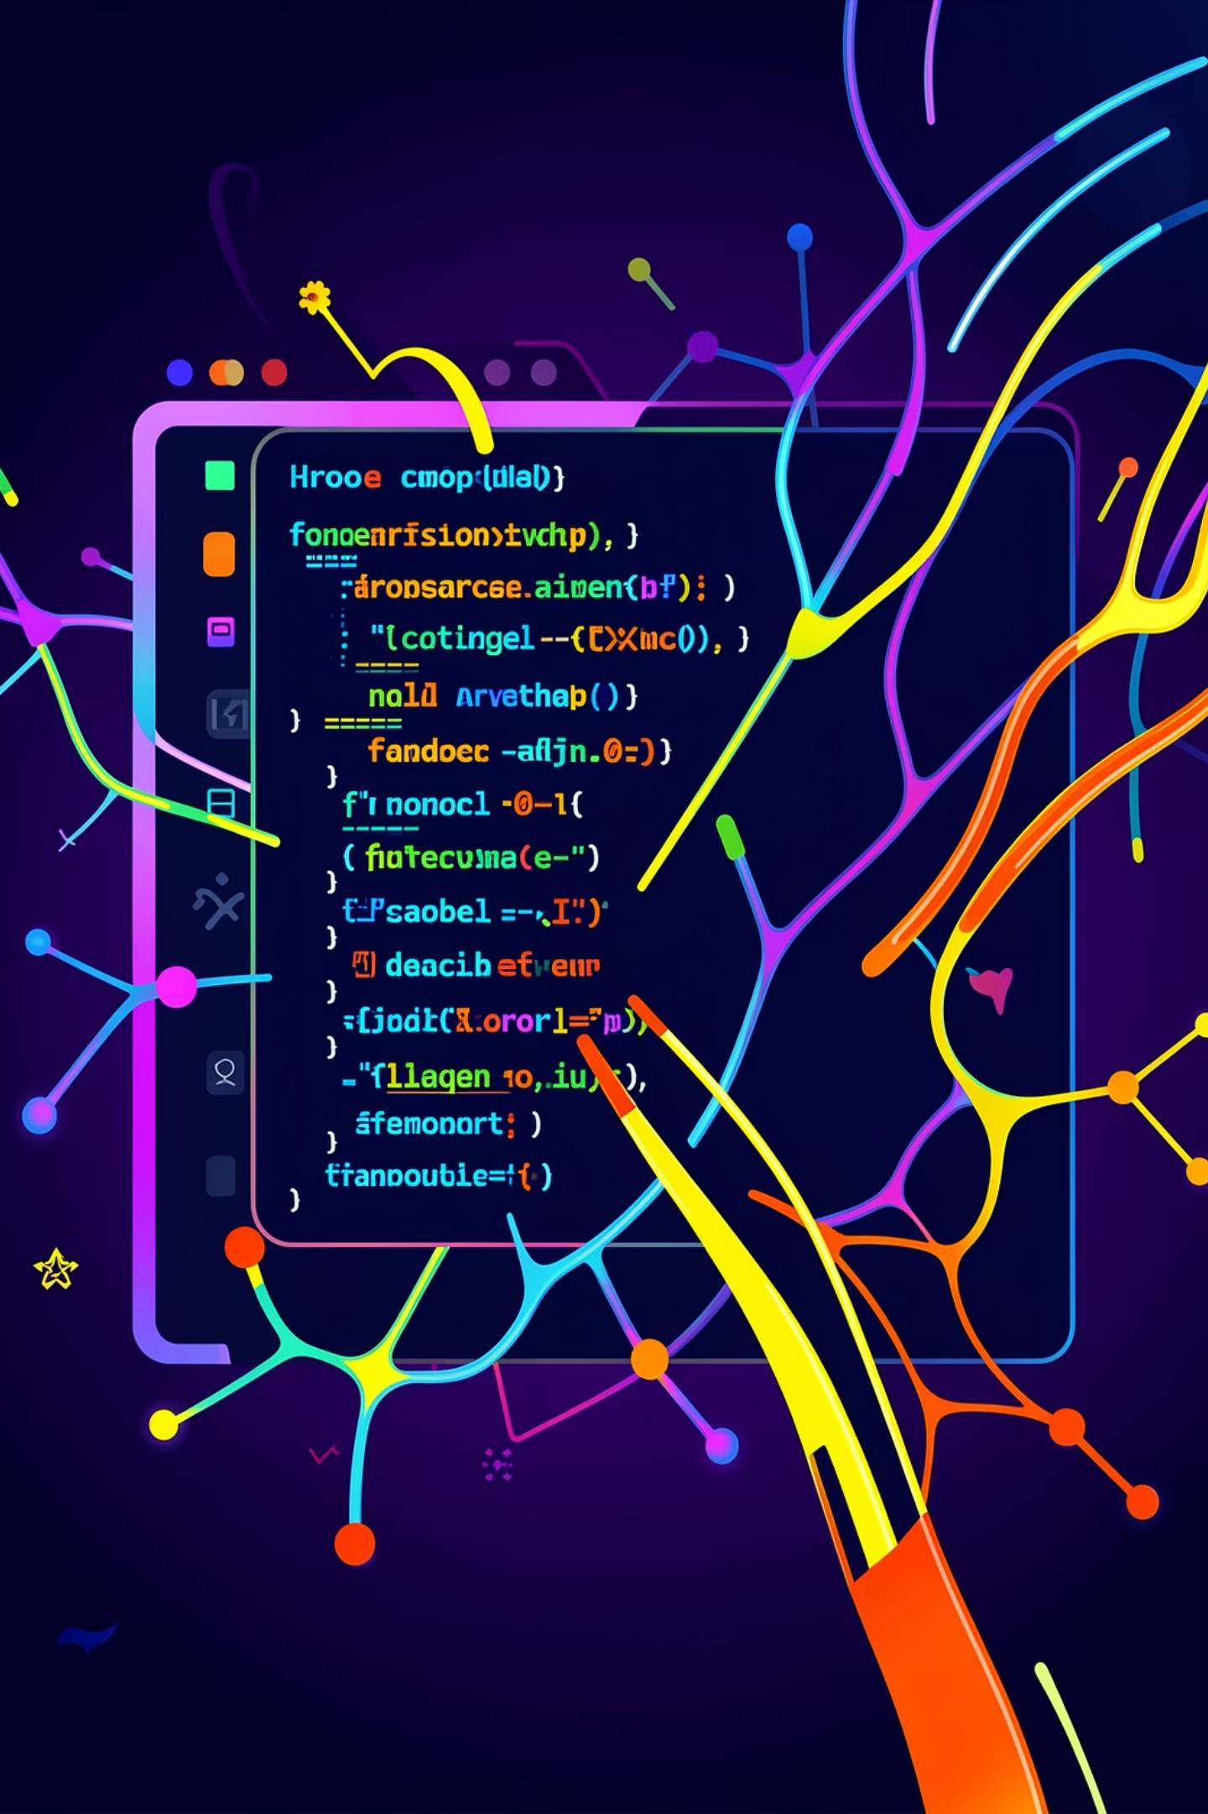
MCA MAJOR PROJECT REVIEW · KIET GROUP OF INSTITUTIONS
CodeCraft
AI Powered Interview Preparation Platform
Divyam Raj ( 202210116100066 )
Divakar Verma ( 202410116100065 )
Divyanshu Mishra ( 202410116100068 )
Guided By: Ms. Annu Yadav

Slide 2

Problem Statement
Current interview preparation platforms fall short in delivering intelligent, adaptive support to candidates.
Static Content
Fixed question banks with no adaptation to user skill level or progress
No AI Evaluation
Absence of real-time, intelligent assessment of candidate responses
No Personalisation
Generic feedback with no tailored guidance or improvement suggestions
No Tracking
No session history, performance analytics, or progress monitoring tools

Slide 3
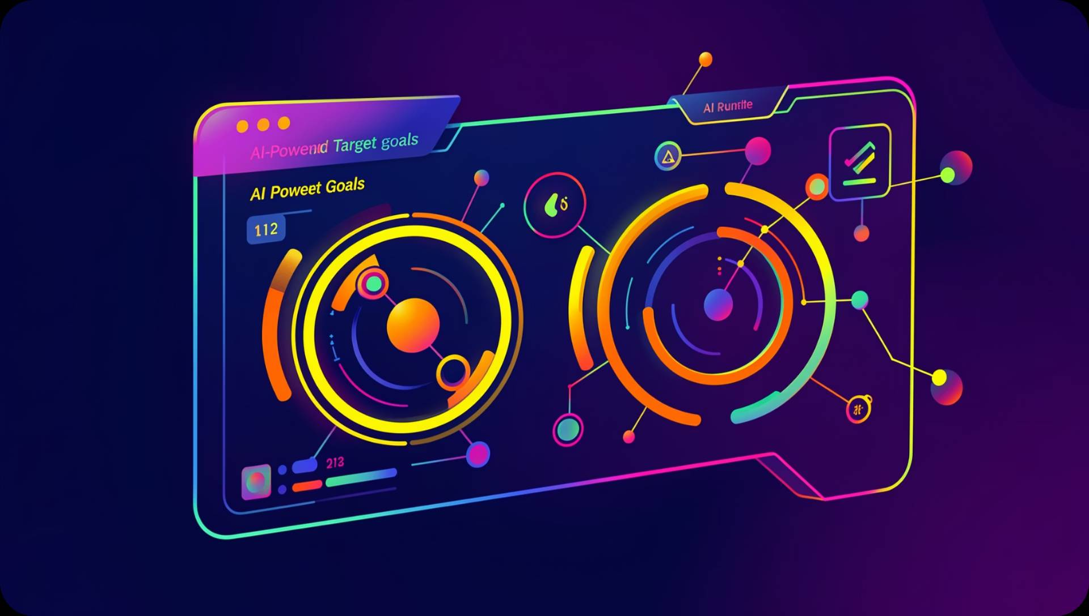
Aim & Objectives
Intelligent Question Generation
Dynamically generate context-aware interview questions using AI
Real-Time AI Evaluation
Provide instant, structured feedback on user responses via Gemini API
Session History & Tracking
Persist interview sessions and enable performance review over time
Modern Responsive UI
Clean, accessible interface built for seamless cross-device experience

Slide 4
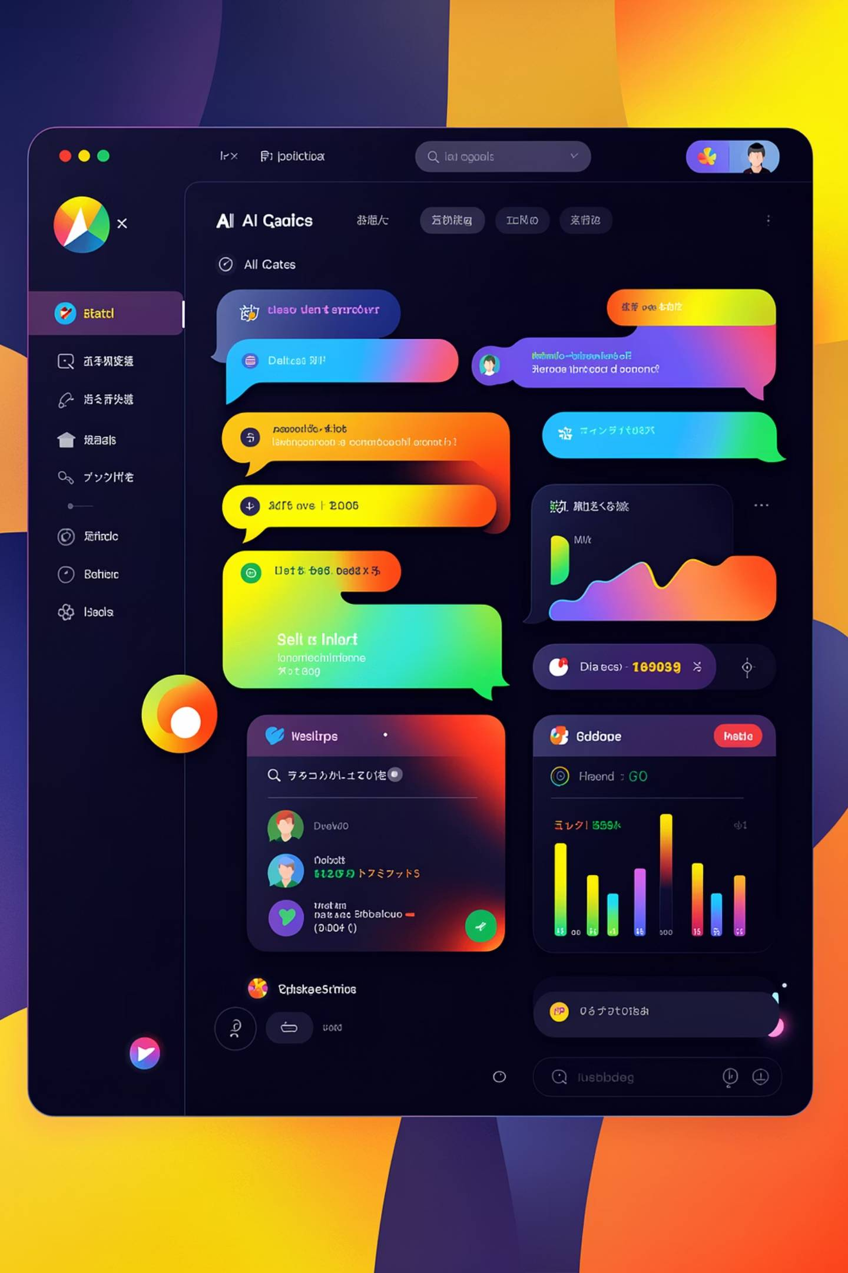
Proposed Solution
CodeCraft is an end-to-end AI-powered interview preparation platform that bridges the gap between static study materials and live mentorship.
AI-Driven Platform
Powered by Google Gemini API for intelligent question generation and evaluation
Dynamic Questions
Questions adapt based on category, difficulty, and user performance history
Personalised Feedback
Structured, actionable feedback delivered instantly after each response
Secure Auth
Clerk-based authentication ensuring secure, seamless user sessions

Slide 5
Technology Stack
Frontend
Backend
Database
Next.js · React.js · Tailwind CSS · ShadCN UI
Next.js API Routes · Node.js
MongoDB for flexible, scalable data persistence
Authentication
AI Engine
Clerk for secure, modern user management
Google Gemini API for evaluation and question generation

Slide 6
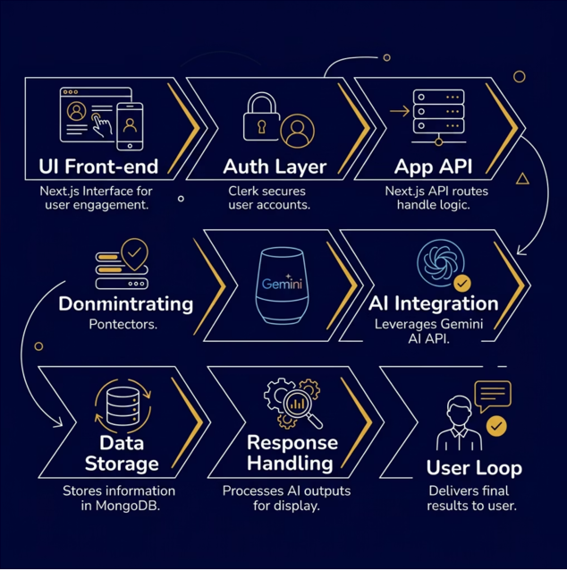
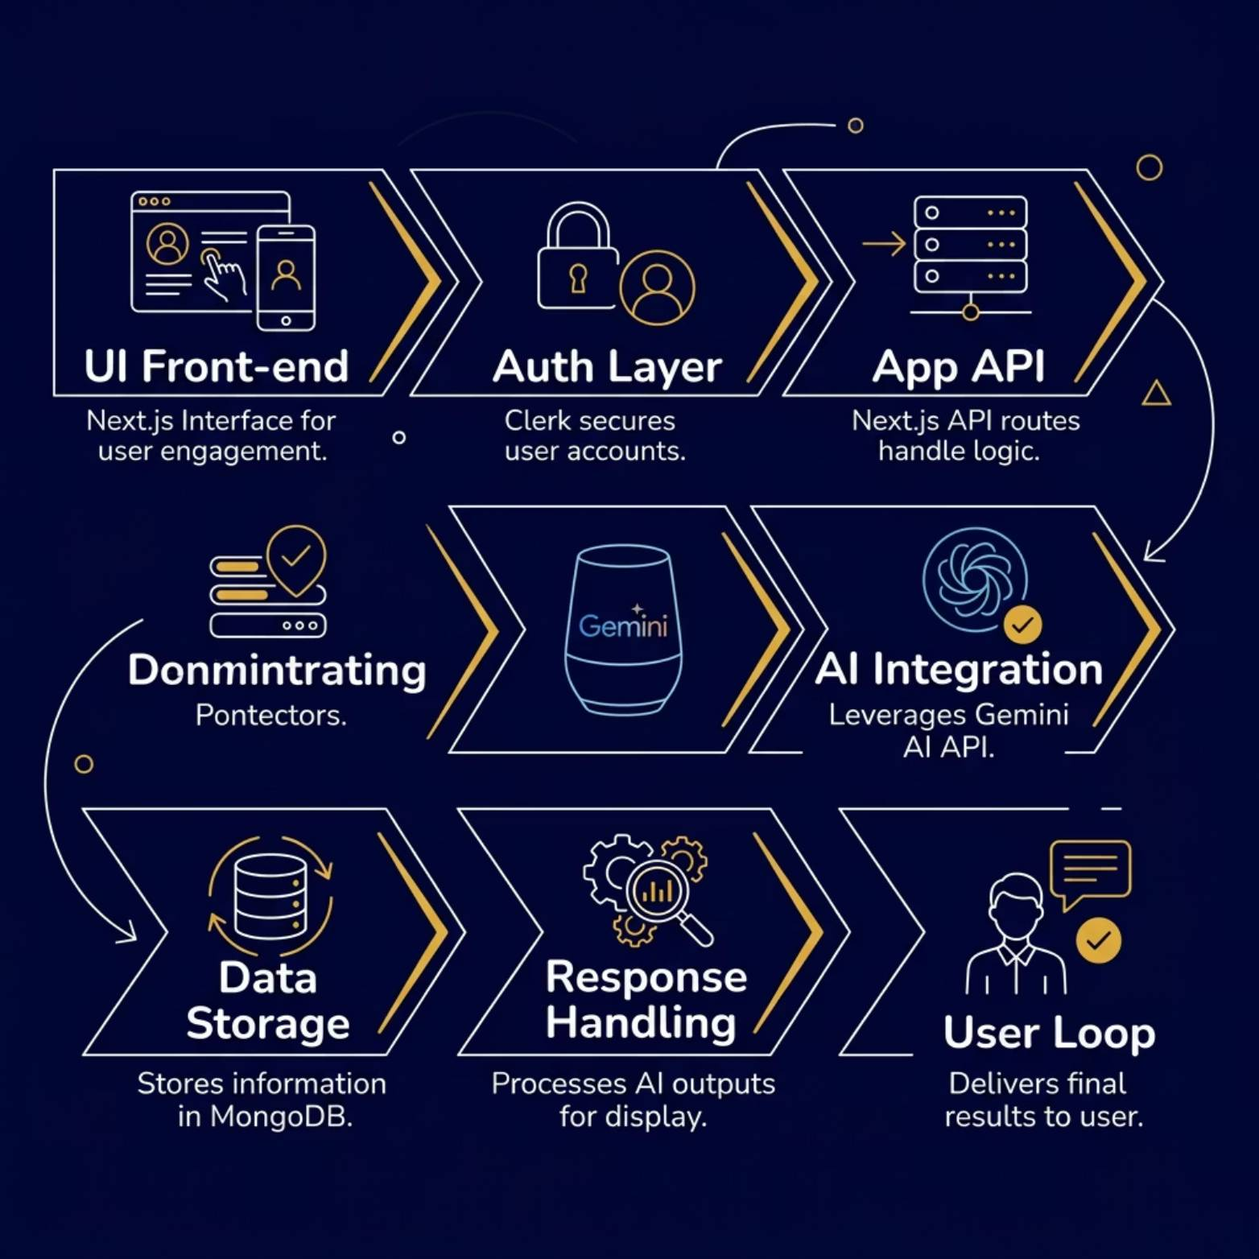

System Architecture
The platform follows a clean, layered architecture ensuring separation of concerns, scalability, and a smooth user experience from authentication through to AI-powered feedback delivery.

Slide 7
Progress Overview
Core modules are actively under development. The table below summarises the current completion status of each component.
90%
80%
UI Design
Authentication
Responsive layouts and component library largely complete
Clerk integration with login, signup, and session management
70%
60%
Dashboard
Database Setup
Main interface with category selection and navigation
MongoDB schemas and connection configured
50%
40%
AI Integration
Session History
Gemini API connected; prompt engineering in progress
Basic storage implemented; analytics pending

Slide 8
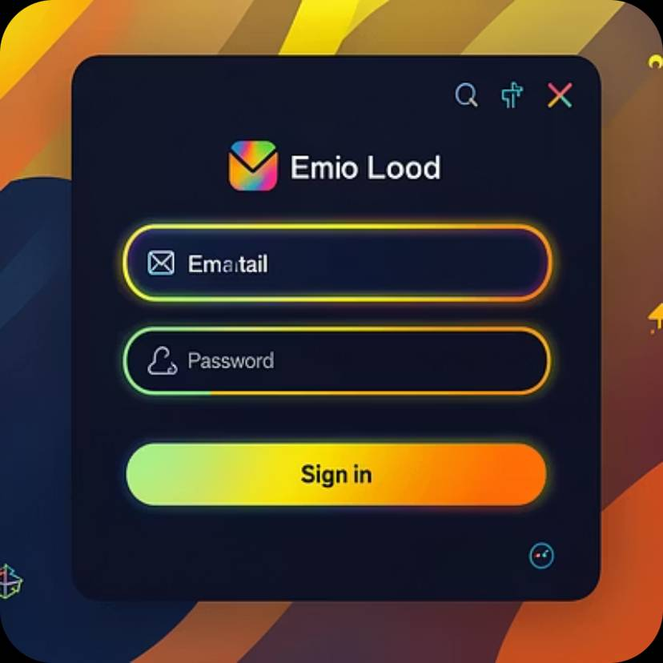
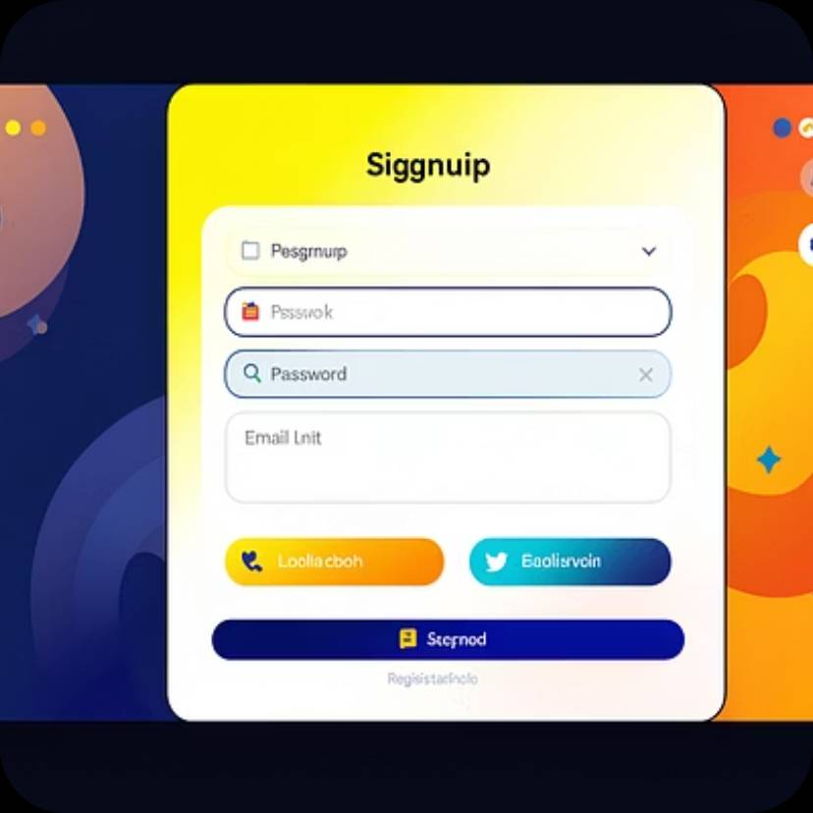
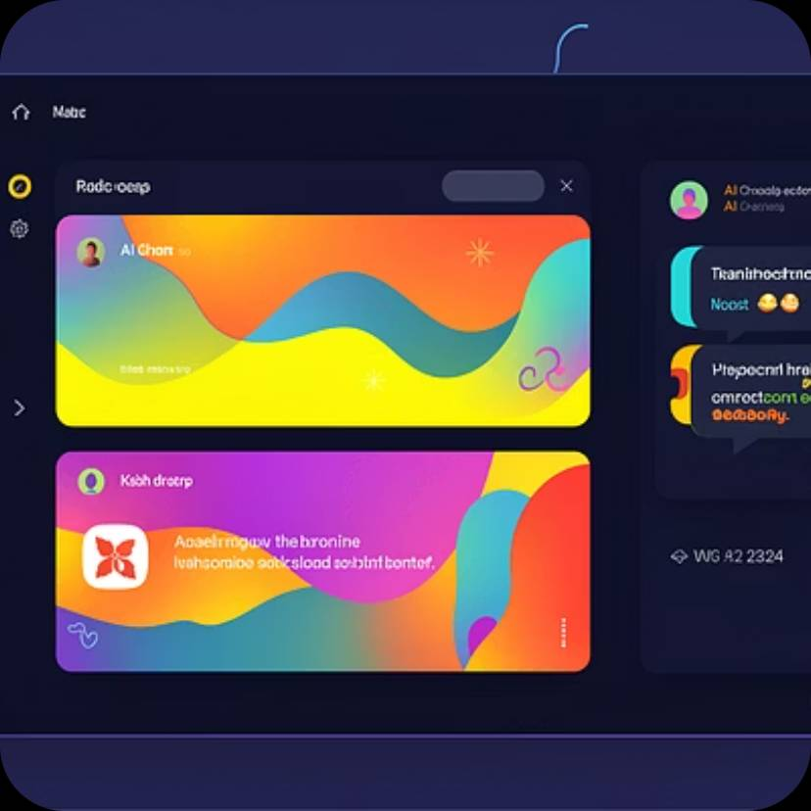
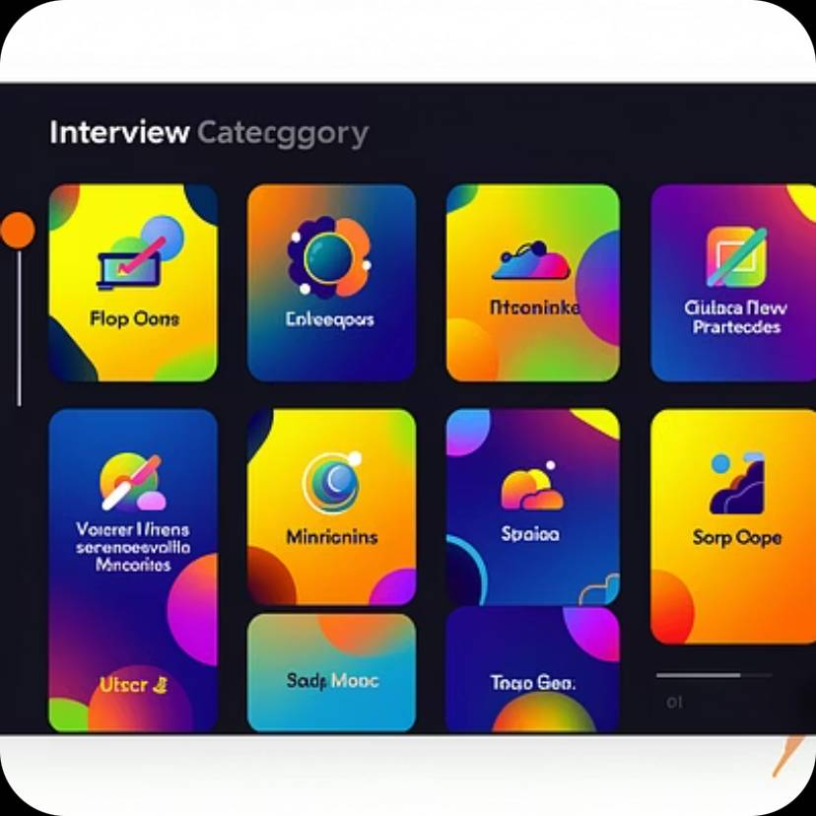
Screens & Working Features
✅ Secure Auth
✅ Dashboard UI
Clerk-based login and signup fully operational
Responsive dashboard with category navigation live
✅ Question Generation
✅ Basic AI Evaluation
Gemini API generating dynamic interview questions
Initial response evaluation and feedback pipeline active

Slide 9
Challenges & Work Remaining
Challenges Faced
Work Remaining
Structuring consistent AI response formats from Gemini
Fine-tuning prompt engineering for varied question types
Managing asynchronous API calls without UI blocking
Maintaining responsive layouts across all screen sizes
Performance analytics and visualisation dashboard
Session history optimisation and retrieval
End-to-end testing and bug fixes
Final deployment and report submission

Slide 10
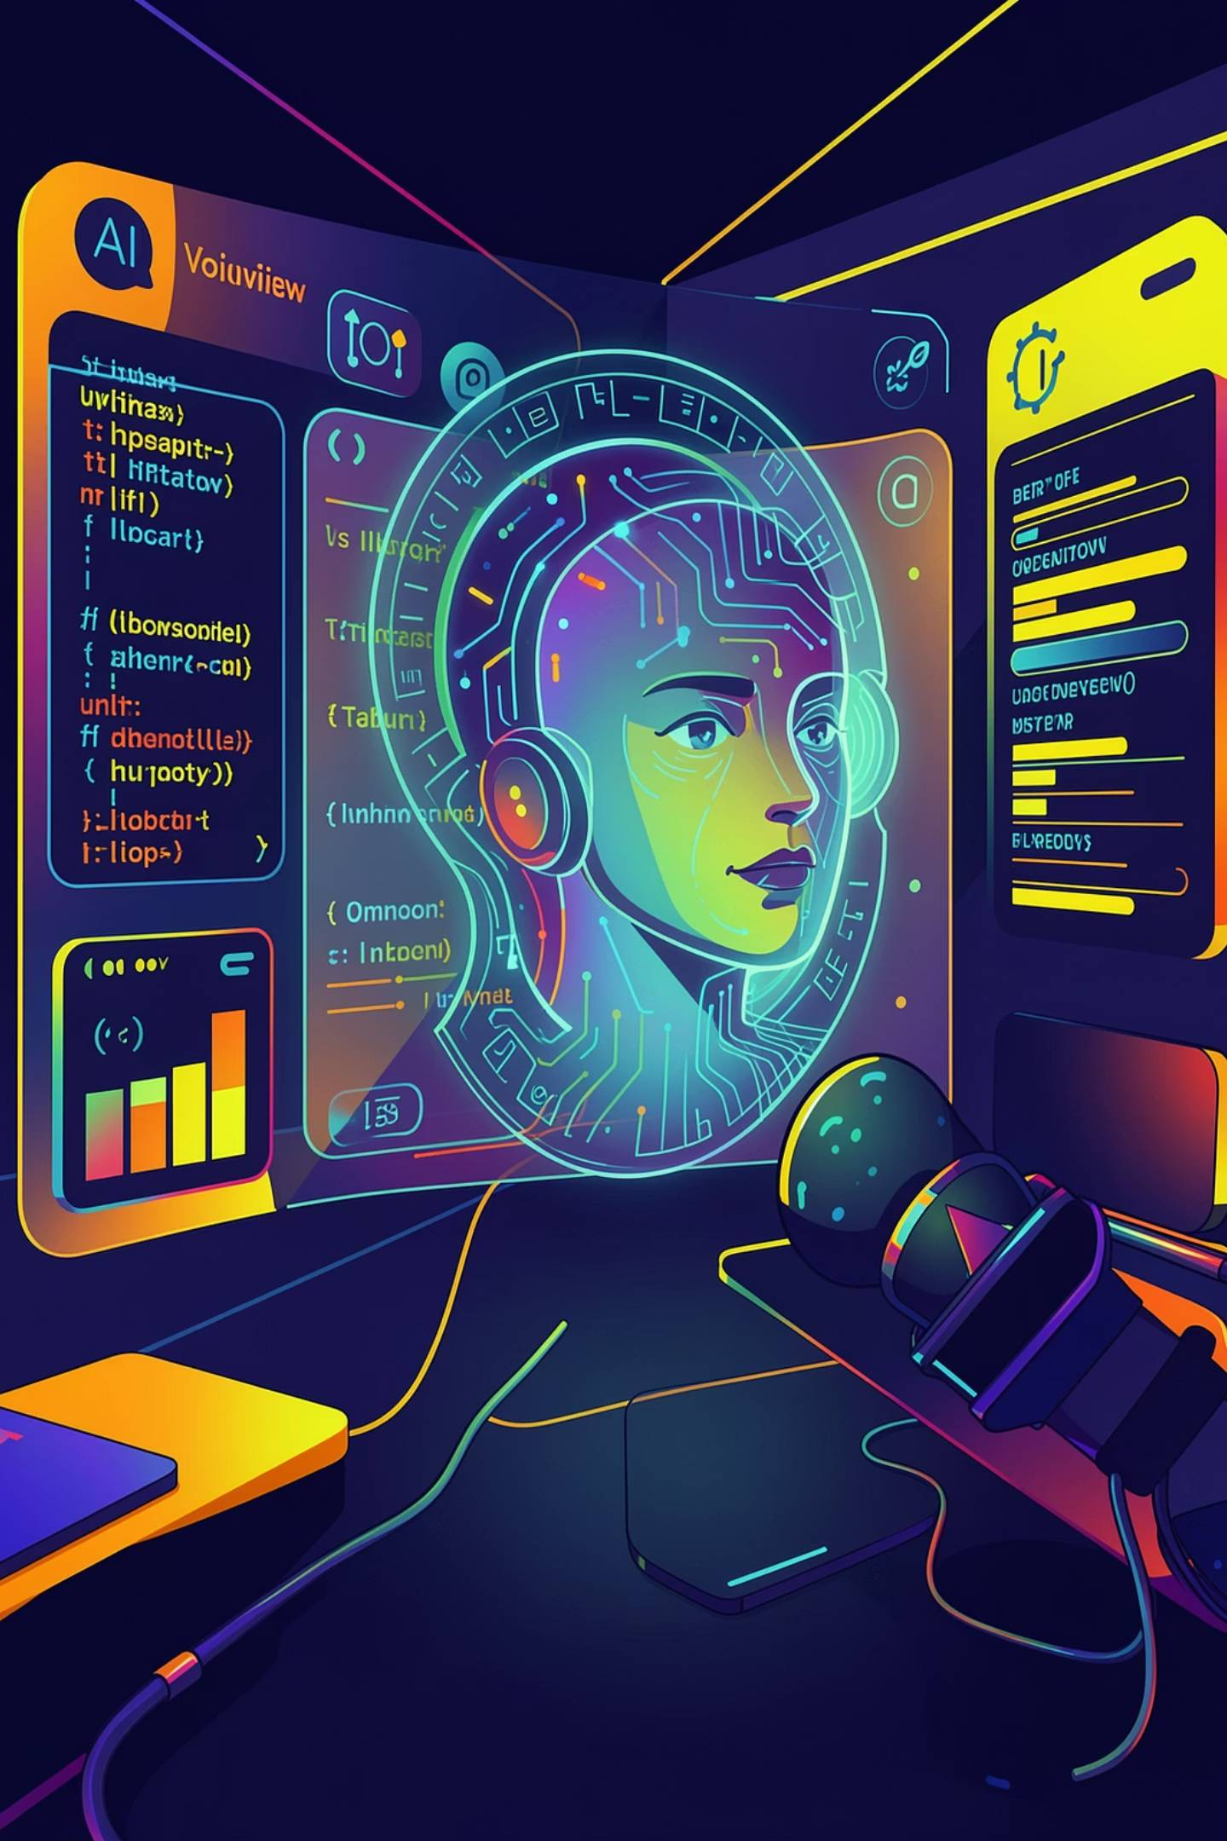

Future Enhancements & Conclusion
Voice Interview Simulation
Speech-to-text powered live voice interviews
Resume Analysis
AI-driven resume scoring and suggestions
Coding Interviews
Integrated code execution and evaluation
Company-Specific Prep
Tailored questions for target organisations
Conclusion: CodeCraft is progressing successfully — core modules are implemented, AI integration is partially complete, and the team is on track for final deployment and testing.
Thank You — Questions & Answers

